Slide 1

Chapter 8: Project Quality Management
Information Technology Project Management, Sixth Edition
Note: See the text itself for full citations.

Slide 2
Announcements
10/27 - Chapter 7, then team breakouts
11/3 - Chapter 8, then team breakouts
11/10 - Chapter 9, then team breakouts
11/17 - Chapter 10 & 11
11/24 - No Class Happy Thanksgiving
12/1 - Chapter 12
12/8 - Final Demo presented; Final reports due
12/15 - Final Exam

Slide 3
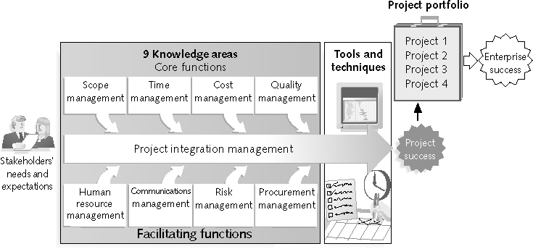
REVIEW: Project Management Framework – 9 Knowledge Areas

Slide 4
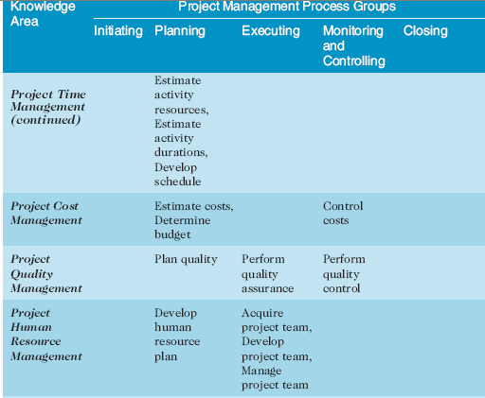
REVIEW:(continued)

Slide 5
Context Diagrams
Good Resource for UML Diagrams: http://www.smartdraw.com/uml-diagram/
http://www.slideshare.net/mohit4192/dfd-examples
UML – Unified Modeling Language: is a general-purpose modeling language in the field of software engineering, which is designed to provide a standard way to visualize the design of a system.
Context-Level Data-Flow Diagram: The Context Diagram shows the system under consideration as a single high-level process and then shows the relationship that the system has with other external entities (systems, organizational groups, external data stores, etc.)

Slide 6
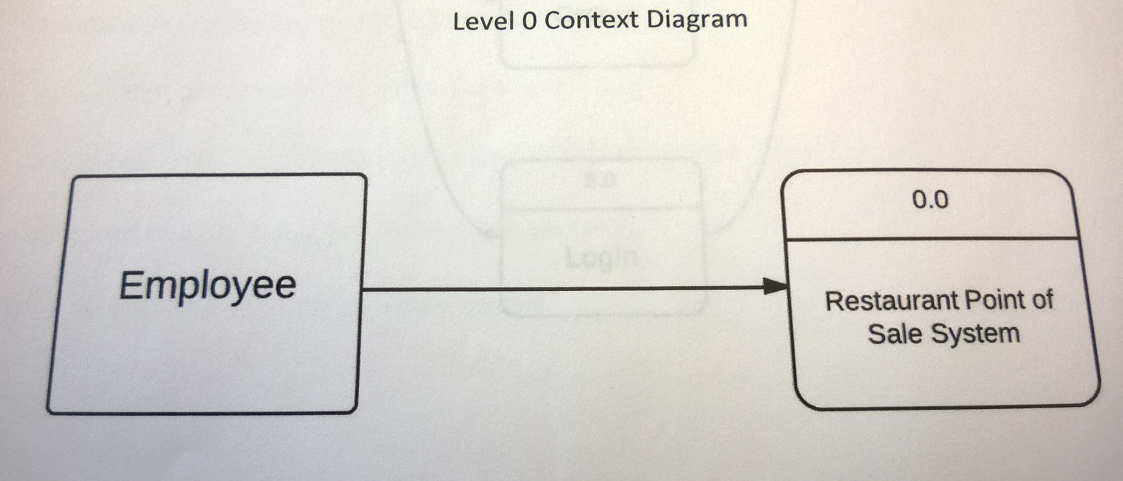
Context Diagrams Examples
Who is the user, and what is the system

Slide 7
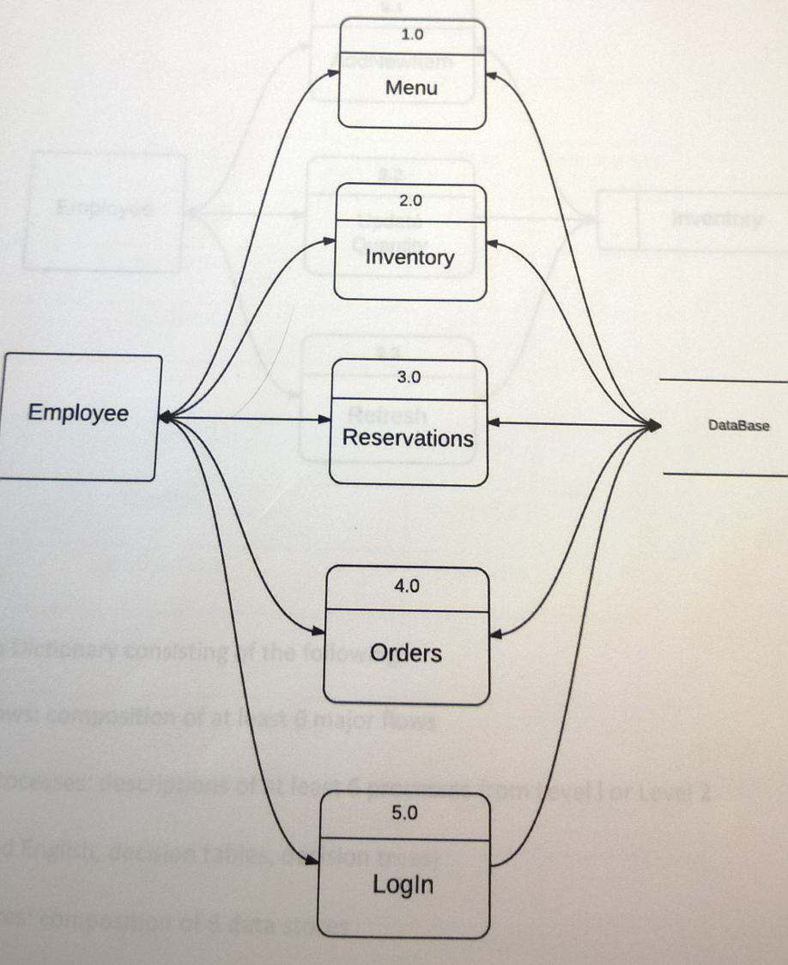
Context Diagrams: Level 1
Who is the user, and what is in the system, what features

Slide 8
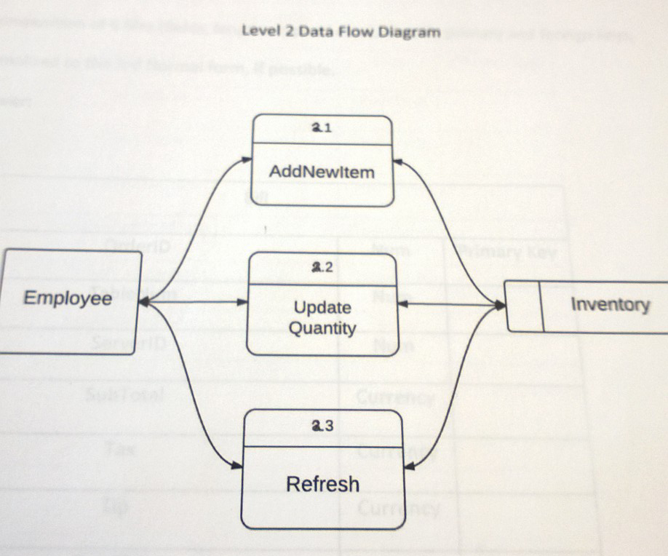
Context Diagrams: Level 2
Who is the user, and what can they do in the system

Slide 9
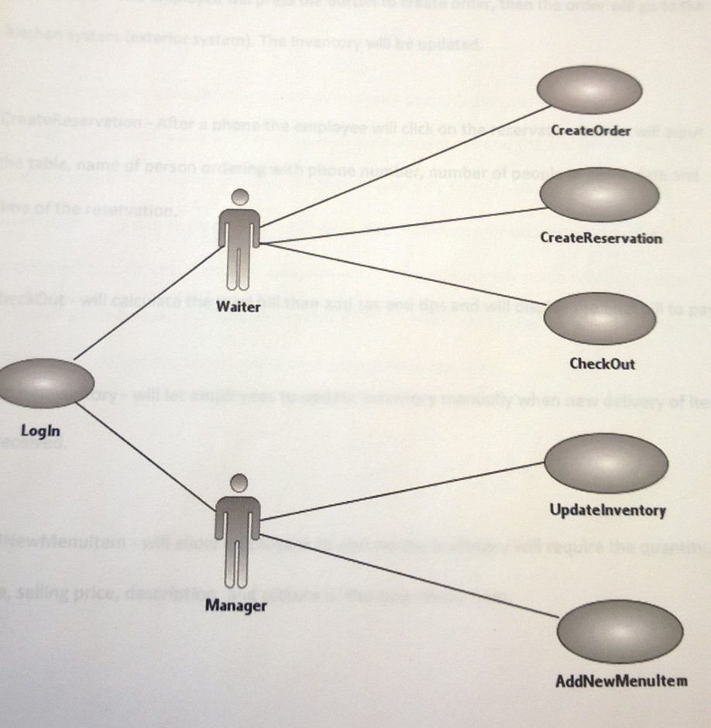
Use Case Diagrams

Slide 10
Activity Diagrams
Activity Diagrams illustrate the dynamic nature of a system by modeling the flow of control from activity to activity.
An activity represents an operation on some class in the system that results in a change in the state of the system. Typically, activity diagrams are used to model workflow or business processes and internal operation

Slide 11
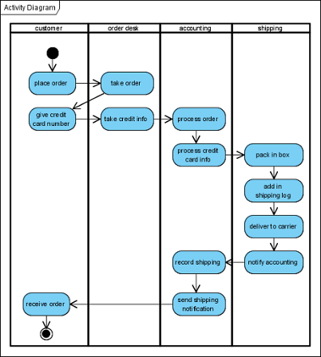
Activity Diagrams

Slide 12
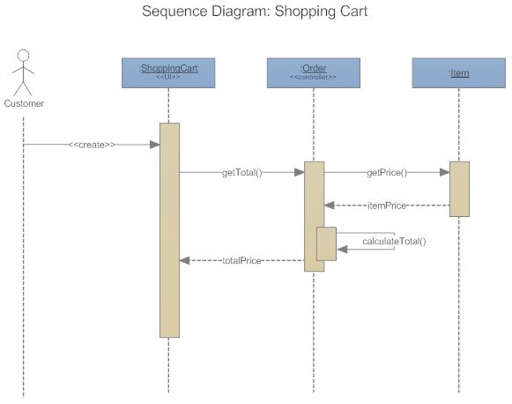
Sequence Diagrams
Sequence Diagrams describe interactions among classes in terms of an exchange of messages over time.

Slide 13
Learning Objectives
Understand the importance of project quality management for IT Projects
Discuss the importance of quality assurance
Explain the main outputs of the quality control process
Describe how leadership, the cost of quality, organizational and cultural influences relate to improving quality in IT projects

Slide 14
The Importance of Project Quality Management
Many people joke about the poor quality of IT products
People seem to accept systems being down occasionally or needing to reboot their systems
But quality is very important in many IT projects and bad products should not have to be accepted!!!

Slide 15
What Went Wrong?
In 1986, two hospital patients died after receiving fatal doses of radiation from a Therac 25 machine after a software problem caused the machine to ignore calibration data
In one of the biggest software errors in banking history, Chemical Bank mistakenly deducted about $15 million from more than 100,000 customer accounts
In a 3 year period, the Privacy Rights Clearinghouse stated that more than 236 million data records of U.S. residents have been exposed due to security breaches

Slide 16
What Is Project Quality?
The International Organization for Standardization (ISO) defines quality as “the degree to which a set of inherent characteristics fulfils requirements”
Other experts define quality based on:
Conformance to requirements: the project’s processes and products meet written specifications
Fit for use: a product can be used as it was intended
Basically, you should expect things to be right not hope

Slide 17
What Is Project Quality Management?
Project quality management ensures that the project will satisfy the needs for which it was undertaken
Processes include:
Planning quality: identifying which quality standards are relevant to the project and how to satisfy them
Performing quality assurance: evaluating overall project performance
Performing quality control: monitoring specific project results to ensure that they comply with the relevant quality standards

Slide 18
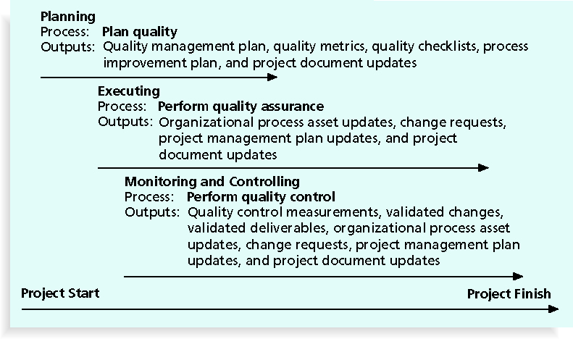
Figure 8-1. Project Quality Management Summary

Slide 19
Planning Quality
Implies the ability to anticipate situations, use the right technology, or materials and prepare actions to bring about the desired outcome
Important to prevent defects by:
Selecting proper materials, tools, technology
Training and indoctrinating people in quality
Planning a process that ensures the appropriate outcome, test and re-test

Slide 20
IT Projects Quality Terminology
Functionality is the degree to which a system performs its intended function
Features are the system’s special characteristics that appeal to users
System outputs are the screens and reports the system generates
Performance addresses how well a product or service performs the customer’s intended use, also at what speed
Reliability is the ability of a product or service to perform as expected under normal conditions
Maintainability addresses the ease of performing maintenance on a product

Slide 21
Who’s Responsible for the Quality of Projects?
Project managers are ultimately responsible for quality management on their projects
But also- organizations and leadership can help project managers and their teams understand and adhere to quality
What about products? what is the orgs stance on quality? If quality goods and services are important then it is everyone's business!

Slide 22
Performing Quality Assurance / Quality Improvement
Quality assurance includes all the activities related to satisfying the relevant quality standards for a project
Another goal of quality assurance is continuous quality improvement
Benchmarking generates ideas for quality improvements by comparing specific project practices or product characteristics to those of other projects or products within or outside the performing organization
A quality audit is a structured review of specific quality management activities that help identify lessons learned that could improve performance on current or future projects

Slide 23
Quality Control
The main outputs of quality control are:
Acceptance decisions
Rework / Fixes
Process adjustments
There are Seven Basic Tools of Quality that help in performing quality control
Cause-and-effect diagram (aka "fishbone" or Ishikawa diagram)
Check sheet
Control chart
Histogram
Pareto chart
Scatter diagram
Stratification (alternately, flow chart or run chart)

Slide 24
Cause-and-Effect Diagrams
Cause-and-effect diagrams trace complaints about quality problems back to the responsible production operations
They help you find the root cause of a problem
Also known as fishbone or Ishikawa diagrams

Slide 25
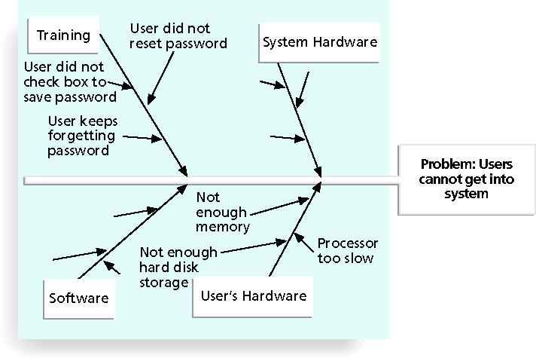
Figure 8-2. Sample Cause-and-Effect Diagram

Slide 26
Scatter Diagram
A scatter diagram helps to show if there is a relationship between two variables
The closer data points are to a diagonal line, the more closely the two variables are related

Slide 27
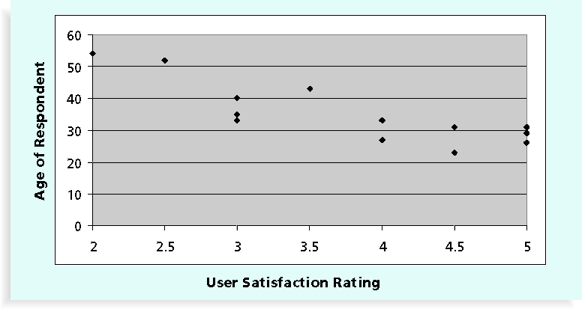
Figure 8-5. Sample Scatter Diagram

Slide 28
Histograms
A histogram is a bar graph of a distribution of variables
Each bar represents an attribute or characteristic of a problem or situation, and the height of the bar represents its frequency

Slide 29
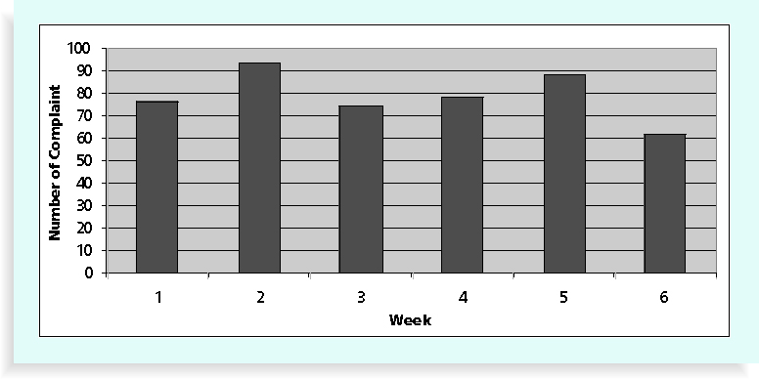
Figure 8-6. Sample Histogram

Slide 30
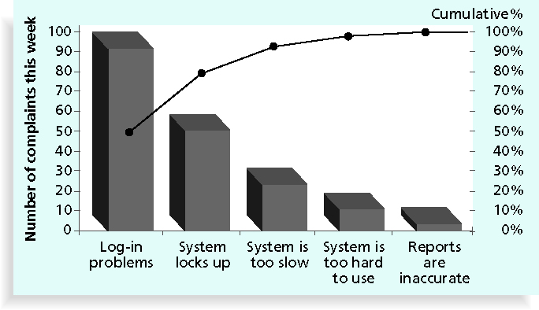
Pareto Charts
A Pareto chart is a histogram that can help you identify and prioritize problem areas

Slide 31
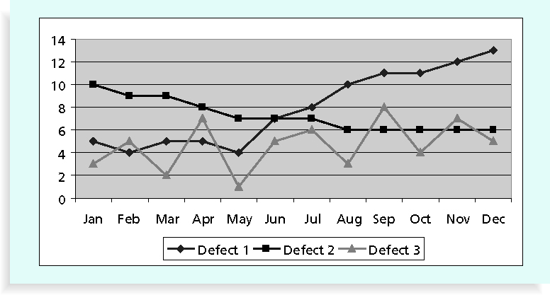
Run Chart
A run chart displays the history and pattern of variation of a process over time
It is a line chart that shows data points plotted in the order in which they occur
Can be used to perform trend analysis to forecast future outcomes based on historical patterns

Slide 32
Flowcharts
Flowcharts are graphic displays of the logic and flow of processes that help you analyze how problems occur and how processes can be improved.
They show:
activities
decision points
and the order of how information is processed

Slide 33
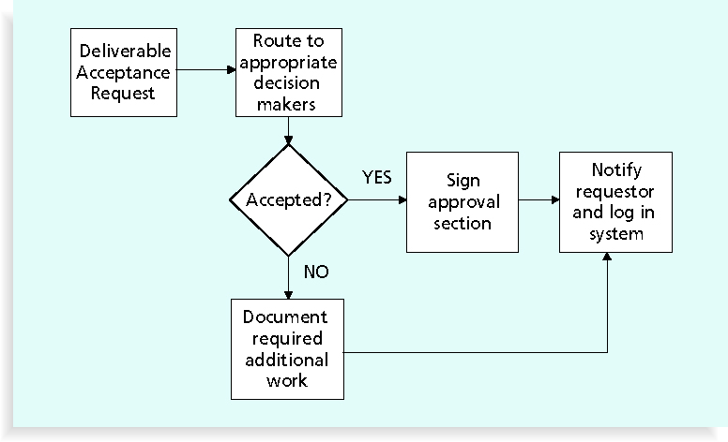
Figure 8-8. Sample Flowchart

Slide 34
Testing
Many IT professionals think of testing as a stage that comes near the end of IT product development
Testing should be done during almost every phase of the IT product development life cycle

Slide 35
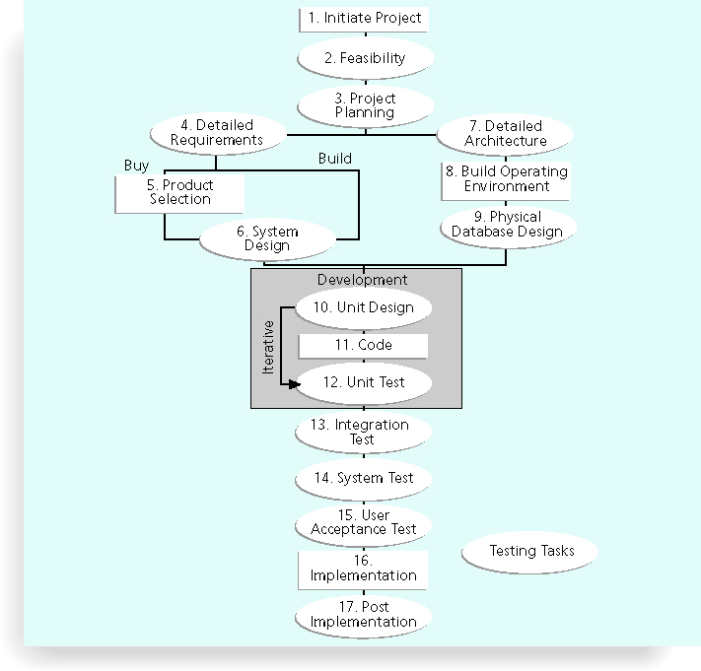
Figure 8-10. Testing Tasks in the Software Development Life Cycle

Slide 36
Types of Tests
Unit testing tests each individual component (often a program) to ensure it is as defect-free as possible
Integration testing occurs between unit and system testing to test functionally grouped components
System testing tests the entire system as one entity
User acceptance testing is an independent test performed by end users prior to accepting the delivered system

Slide 37
Improving Information Technology Project Quality
Suggestions for improving quality for IT projects include:
Establish leadership that promotes quality
Understand the cost of quality
Focus on organizational influences and workplace factors that affect quality
Follow maturity models

Slide 38
The Cost of Quality
The cost of quality is the cost of conformance plus the cost of nonconformance
Conformance means delivering products that meet requirements and fitness for use
Cost of nonconformance means taking responsibility for failures or not meeting quality expectations
A study reported that software bugs cost the U.S. economy $59.6 billion each year and that one third of the bugs could be eliminated by an improved testing infrastructure

Slide 39
Five Cost Categories Related to Quality
Prevention cost: cost of planning and executing a project so it is error-free or within an acceptable error range
Internal failure cost: cost incurred to correct an identified defect before the customer receives the product
External failure cost: cost that relates to all errors not detected and corrected before/after delivery to the customer
Measurement and test equipment costs: capital cost of equipment used to perform prevention and appraisal

Slide 40
Expectations and Cultural Differences in Quality
Project managers must understand and manage stakeholder expectations
Expectations also vary by:
Organization’s culture
Geographic regions

Slide 41
Chapter Summary
Project quality management ensures that the project will satisfy the needs for which it was undertaken
Main processes include:
Plan quality
Perform quality assurance
Perform quality control

